Slide 1
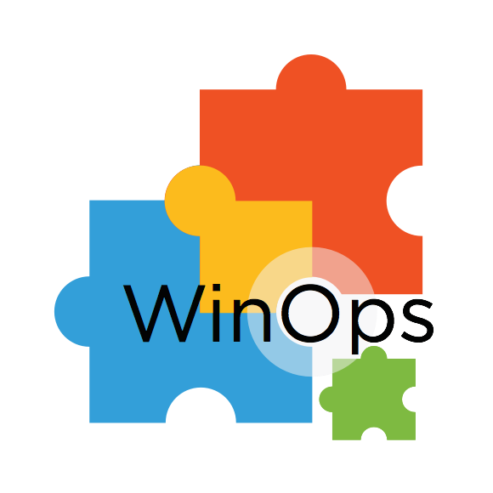
Idempotence and Immutability
Configuration Management Theory
Notes:
Good afternoon and Welcome to a presentation about Idempotence and Immutability.
That may sounds new and shiny, but it’s only concepts of Configuration Management Theory.

Slide 2
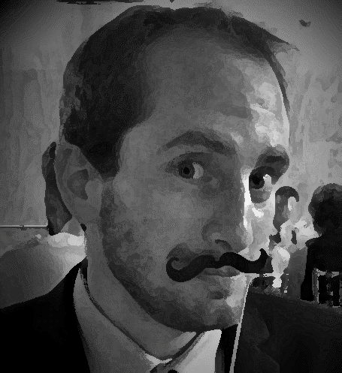




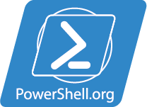
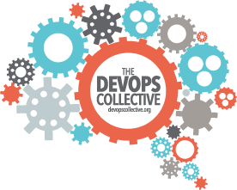
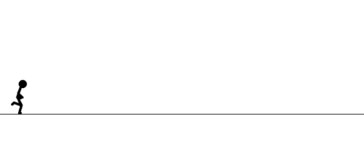
Gael Colas Cloud Automation Architect
@gaelcolas
My Ads
Operations
Engineering
Automation
PaaS/IaaS Development
PSCONF.EU
Dev
Ops
Notes:
My name is Gael. I’m a “Cloud Automation Architect” consultant.
I come from an Ops background where I started in 1st line support for IT.
I evolved towards engineering, before focusing mostly on automation, to end up where I am now, developing PaaS and IaaS solutions for a Cloud Provider.
In short that stickman is me, having fun and inadvertently ending up on the Dev side.
I’m a DevOps enthusiast, I attend the WinOps meetups which I recommend.
Because sharing is caring, I try to write anything technical in my new blog, and DevOps related stuff on DevOpsCollective.org, which is maintained by the not for profit organization DevOps Collective, also running PowerShell.org and the PowerShell and DevOps Summit in the US. This effort is led by Don Jones, and other celebrities.
I’m also advertising for the European PowerShell Conference which was last month in Hanover, we had a blast. We had the chance to have Jeffrey and Bruce Payette along with about 40 speakers and 200 delegates. It’s a PowerShell deep dive driven by the community. Should you have more question, ask Ryan Rates, CDM MVP (Cloud and Datacentre Management), who helped Tobias to organize the conference.
Ok, promotion done, lets dive in ☺
I work for Interoute, but opinions shared here are my own.

Slide 3
Definitions
Immutable
An object whose state cannot be modified after it is created. Wikipedia
Idempotence
Can be applied multiple times without changing the result beyond the initial application. Wikipedia
You want Idempotence, AND convergence to a finite state.

Slide 4
Our Goal today
Quick look at configuration Management approaches
An exploration down the rabbit hole
Paradigm shift
Glimpse of the (close) future
Notes:
A Paradigm shift is a fundamental change in the basic concepts and experimental practices of a scientific discipline. [Wikipedia]

Slide 5
The Approach
Bad: The pets
Better: The cattle
Best: The Chickens
Notes:
So before we look start diving in, I’d like to do a quick poll to see where you are in your Configuration Management journey.
I’d like to make a distinction between two very rough and simplistic category of IT:
Web Shop IT: technology used to reach customers and generate value.
Enterprise IT: the technology supports the business functions, which in turn generate value.
I want to encompass both, but the context they evolve is slightly different in my opinion. Maybe it shouldn’t, but it is.
Assuming anyone else is in the other group, who feels they’re operating more in the Enterprise IT context? Now Keep your hands up if less than half of your systems are configured manually (running a script per machine interactively is considered manual here).
Thank you, hands down.
Those in Web Shop kind of IT, hands up if less than 50% of your servers are configured manually.
Thank you.
Now together, hands up if your average server OS installation has a life expectancy more than 2 years. Keep it up if more than 1 year. And 6 months.
Who patches their server every months?

Slide 6

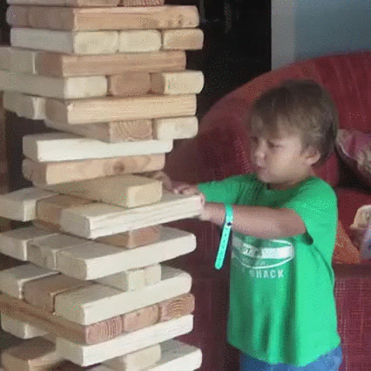
BAD: the Pets
What mindset?
In the Trenches?
Provide a catalogue of service
Everything is mission critical
No unexpected down time allowed
Planned downtime, OoOH,
if you beg long enough
Build once – don’t touch, ever
Small patch is a quick win, right?
Management said ‘done by Yesterday’
Don’t trust the doc, it’s out of date
Ask Bob, it’s his box, he’s done black magic
Changes are too risky, don’t do it
Why? Because downtime is painful, and Recovery is hard!
Notes:
Do you know who’s that kitten?: Pussy in boots. If you can do the same about a server, then it’s probably your pet.
Just by its picture, or name, its charachteristics, story, where it comes from.
A pet, when talking about server, it’s:
Individually crafted,
time invested in each of them,
Owned and cuddled by someone (willingly or not)

Slide 7
The Deep dive with the 5 Whys
Why do we have this mindset?
Because downtime is painful, and Recovery is hard!
Recovery takes a long time, business is impacted, Ops are busy firefighting
We thought controlled change would have no impact, but this is more complex
Probably because of domino effect, the state of the machine was not as we expected
Maybe the person doing the changes did not know its exact configuration
“The first step in solving a problem is to recognize that it does exist.” Zig Ziglar

Slide 8



Down the Rabbit Hole
The Problem
CHANGE 1
CHANGE 2
CHANGE 3
Mike
Scott
Joe
What could possibly go wrong?
Notes:
For a given node in a given configuration state A,
Mike, Scott and Joe are Ops Engineers configuring the node.
Mike goes on the running the system, and makes a configuration change ‘1’. State = B
Scott assumes Node is in configuration communicated by Mike, and makes ‘2’, another change. State = C
Joe makes a tiny change ‘3’, such as adding RAM, and then restart the machine in state D.
What could possibly go wrong…?
Think Registry change, Installing update, Delete System file…
Lets roll back: What to roll back? How to roll back?
Who Knows? One guy, Mike, knows “how it should be”, it’s his server. He takes care of it.
A.K.A. Who’s pet is that?

Slide 9
An abstraction model for Configuration
Mathematical Thinking and problem solving
CHANGE 1
CHANGE 2
CHANGE 3
AB
BC
CD
A
B
C
D
BA
CB
DC
Rollback
Rollback
Rollback
Notes:
This is where teams usually respond with solutions such as: We need a Configuration Management procedure, a CAB (Change Advisory Board), better documentation… or we hear No it’s about culture, collaborate more! Lets leave this aside and dig further.
What’s happening after the change, is that the system is in a different configuration state.
Each state of the configuration has a name “A”, “B”, “C”, “D”. Each change is a vector between two states: AB is a vector, could be installing a package, or enabling a feature.
Each change, needs a different vector (an action) to roll back to a previous state: Enable-WindowsFeature, Remove-WindowsFeature.
And still I’m optimistic, I don’t talk about those roll back that leaves things behind…

Slide 10
An abstraction model for Configuration
Mathematical Thinking and problem solving
C
CD
BC
AB
D
A
B
CB
DC
BE
BA
DF
FD
EB
E
F
Notes:
And for a single system kept alive, over time it may have different purposes, and end up with different configuration state.
What’s happening, but no-one dare saying, is that we expect from the SysAdmin to know in a point in time:
What’s the current state (remember, that SysAdmin probably did not set the config)
How to move from that State to any other, without breaking stuff (has this transition ever been tested?)
Do it quick, how hard can it be?
So what clever people do? They create an abstraction layer, to be able to handle the complexity.
If you only care about state E and F, say a WebServer and a File Server. This view, can be simplified…

Slide 11
An abstraction model for Configuration
Mathematical Thinking and problem solving
A
E
F
Notes:
… Like this, or even better …

Slide 12
An abstraction model for Configuration
Mathematical Thinking and problem solving
F
A → F = ABBCCDDF
A
E
A → E = ABBE
Notes:
… Like this.
remember this is still only an abstraction model to get to F and E, so it’s easier to handle the complexity: we generally call F and E, roles.
To get to role F or E from your base A, you still need to replay the full configuration ABBCCDDF.
So, in a best case scenario, people put that path: ABBCCDDF into documentation: How to install Role F.
People install those roles… sometimes many times a week… manually...! Oh, what’s the problem with human again? They do mistakes…

Slide 13
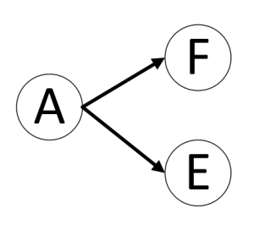
An abstraction model for Configuration
Mathematical Thinking and problem solving
For x the number of configuration State,
y the number of transitions.
In the abstracted view y = x -1
In reality, when you expect the sysadmin
To support each transition, including rollback,
of each state:
The number of transitions is y = (x*(x-1))
Notes:
But never mind the mistakes for now. Lets keep digging… One last time!
Do you want all those potential transitions to go through a change advisory board?
Are they recorded to start with?

Slide 14
Aim for immutability
Mathematical Thinking and problem solving
A
E
F
Notes:
So getting back to that graph. Now that you know the cost, in terms of number of transition to support to get from A to E and F, you want to simplify the system - not just abstract it - and only support transitions in an explicit way.
You drive your configuration with what to expect, that’s the first thing to find out: you want the state E to be… list specifics here.
That means any transition to a system state must be supported from a Start to an End.
The only way to do that, is to aim for Immutability. And I say aim for a good reason, we’ll get there soon.
The other quality you’re doing with your system driven by a policy (the end state), is Idempotence. In complex systems, things happen along the way. Machine may reboot, you have multiple system interacting together, you forgot one part…. You want to be able to replay the configuration over, no matter how often, and converge to the same end state.

Slide 15
Transitional state
A custom template or image is not a starting point
X
Notes:
I just want to make a note here, as it’s a common scenario, where people try to simplify their workflow, and sometimes end up build technical debt.
X here is a transitional state, to get to the two end state.
So, to make getting to those end state quick and easy, we usually create a Snapshot, template, image whatever you want to call it.
This makes sense, and I have nothing against that, but just a word of warning:
It’s clear in that model, that X is a transitional state to get to either end.
Also, X could be your end state. If you have lonely a few images to manage and they don’t change very often, why not.
If they’re windows image, and the only thing you’re doing is adding updates to them, then you can use DISM for offline servicing
But because they are only a state, as in a result of actions, then you should make sure you’re able to replay the actions automagically on a click of a button, or better on a git push.
Any definition change that affects a state before x inclusive of x, re-triggers the whole build (probably 3 times).
Any definition change that only affects something after x exclusive, triggers the last legs of the build (the branch it depends on)
It might be obvious and common sense, but I’ve seen people going to X, manually, then keeping that template, and from that template, going to other states templating again. When it comes to changing X slightly well, let’s just hack it, and re-template.
New OS version comes in, how long will it take rebuild to X based on a new version…? Do you even remember how to get to X?
What if a change to X just fails to install… how do you try to isolate the problem?
What if you have multiple levels of X?
Don’t cut corners, build your pipeline, end to end, then optimize with Optional checkpoint based on what has changed.

Slide 16
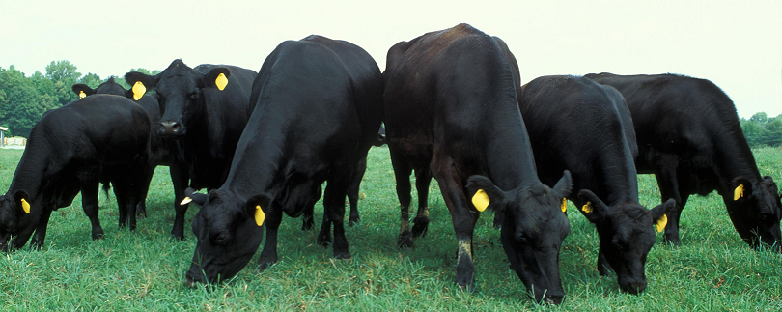
Better: The Cattle
What mindset?
In the trenches?
Provide a catalogue of service
High MTBF and low MTTR, it WILL die anyway…
quick recovery, not avoid failure
Minimum unexpected down time
Not because of human error
Down time of a server ≠ down time of service
Policy Driven Infrastructure - IaC
Versioning traces changes to policy
Catch problem early
Test thoroughly, and all its dependents
Does it add the expected value?
Does it work without causing an outage?
How do I keep it consistent over time?
YES! The Release Pipeline Model!
Notes:
The cattle: You identify a unique individual by its ID.
You craft the mould, not the individuals.

Slide 17
Why does this work?
You know what you are expecting: The policy
You know what as changed, by whom, and hopefully why: The versioning
You know they work: The tests
You know they’re delivered: The operational validation
If it does not work after release:
Rollback the policy if necessary
Catch (in test/Validation) and it will never happen again
Notes:
“I have not failed, I’ve just found 10,000 ways that don’t work” Thomas A. Edison

Slide 18
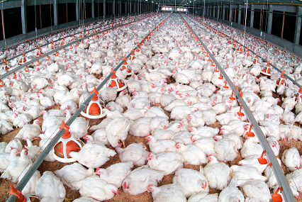
Best: The Chickens
The horrible but true analogy
Short life expectancy
Small foot print per unit
Cheaper to replace than fix or change
Undifferentiated from similar species

Slide 19
Why *aiming* for immutability?
Big footprints slows transitions
Say you have a 100GB image to roll out to 100 servers, it takes time to generate, distribute and roll out
You have dependencies
You have collocated roles on a server: one service can’t have down time
Simple transitions cheaper because of footprints
Adding Cores
Adding RAM
Offline patching of an image
KEEP TRANSITIONS TO A MINIMUM, AND EXPLICIT

Slide 20
Chickens: Containers & Nano Server
Small footprints
Can change, test and distribute fast
Shorten the iteration/feedback loop
Decoupled tasks
microservices architecture
Higher number of short-lived, small footprints systems
Immutable
Container: The Transparent sealed box, for dedicated service
Nano: Headless server, cheaper to replace than fix

Slide 21
Summary
Use the Release Pipeline Model
Don’t migrate, but Reverse-engineer your servers
Use a Policy Driven Infrastructure – aka Infrastructure As code
Test your convergence and validate the delivery
Manage your servers like cattle
You define the roles you need, the CM ‘makes it so’
They’re almost identical, and go through the same automated mould
Their name does not matter
Aim for chickens
Think immutability, microservices, Nano server, containers, and Event Sourcing

Slide 22
Questions?
PSCONF.EU
@gaelcolas
Thank you. Feel free to grab me for a chat!

Slide 23
Enough Time for a quick DEMO?
Your Next step:
How To reverse Engineer your Server Config?
Remember that Chef, Puppet (tools) support DSC (platform)
ChefDK + Test-Kitchen + Kitchen-DSC (+ kitchen-hyperv)
You don’t need to know or use Chef
Getting Started
Workflow
New
KitchenVM
Connect
Configure
TEST

